Slide 1

BLY 121: GENERAL BIOLOGY II
TOPIC: ECOLOGICAL ADAPTATION OF THE PLANT KINGDOM
BY
DR GBENGA AKOMOLAFE
DEPARTMENT OF PLANT SCIENCE AND BIOTECHNOLOGY
FEDERAL UNIVERSITY OF LAFIA

Slide 2
Importance of Plants
Plants the only organisms capable of converting solar energy to chemical energy (i.e. producers)
All consumers dependent on plants for food, fibre, wood, energy and oxygen
People rely on plants for much more than food and shelter: immobility, carbohydrate production and diverse biochemistry make plants far more useful to humans than any other group of organisms

Slide 3
Other Uses of Plants
Plants rely on wind and water to move their pollen and seeds, or alternatively entice animals to do these for them.
This is the essence of flowers and delicious and nutritious fruits.
Not all animal-plant interactions are, however, benign
Animals pose a threat to plants and plants have therefore become specialists in animal biochemistry

Slide 4
Some other issues for botanists:
The principles underlying the great diversity of plants
The mechanisms that control the precise pattern of growth
The kinds of plants growing under what conditions of temperature, soil, moisture and nutrients that will produce most abundantly, since plants are the only producers
Relationships of plants to their environment, and how the harmful changes in the biosphere can be reversed

Slide 5


EVOLUTION BY NATURAL SELECTION
Darwin’s theory of evolution by natural selection:
Individuals that make up a population are not identical – they vary;
Some of the variation is heritable
All populations have the potential to populate the whole earth – but they don’t, due to various reasons
Different individuals have different numbers of descendants – differing chances of survival to reproductive age, vagaries of nature etc.
The number of individuals left by an organism depends crucially on the interactions between the characteristics of the individual and its environment

Slide 6
ADAPTATION
Any behavioural, morphological or physiological trait that is assumed to be the result of natural selection;
Physiological or morphological feature or form of behaviour used to explain the ability of an organism to live where it does
Change in physical, physiological or behavioural traits that results from some current environmental pressure, such as adapting to a change in temperature
Key to adaptability is diversity of genetic characteristics (genotypes) found among the local populations of a species

Slide 7
ADAPTATION OR ABAPTATION?
Some environments may be favourable, others not; hence natural selection
Reasonable to say that the organisms of the present are abapted by the environments of the previous generation. Past envts act as filters.
Organisms appear to be adapted to present envts because present envts tend to be similar to past ones
Adaptation gives the impression of prediction, forethought or design. Organisms are abapted by their past.
Organisms live where they do due to accidents of history – fitness (biological = contribution an organism makes to future generations)

Slide 8
Ecotypes, Phenotypes
Plants adapted to local conditions are called ecotypes
Phenotypes are physical expressions of the genotype and its interactions with the environment
Phenotypic responses may be morphological (Physical characteristics), physiological (functional characteristics) or phenological (timing of growth and other life history changes stimulated by seasonal changes in the envt.)

Slide 9
On Conditions and Resources
To understand the distribution and abundance of a species, we need to know:
History of the species
The resources that it requires
Factors that influence its rate of growth
Interactions
Effects of environmental conditions

Slide 10
Condition
An abiotic environmental factor which varies in space and time, and to which organisms are differentially responsive; e.g. temperature, relative humidity, pH, salinity, stream flow velocity and concentration of pollutants
May be modified by the presence of other organisms
Not consumed or used up by an organism or made unavailable or less available to others

Slide 11

Resources
All things consumed by an organism
‘consumed’ not necessarily eaten but be made unavailable to other organisms; stock or supply has been reduced
Resources are incorporated into the organism
Examples: radiation, inorganic molecules (carbon dioxide, water, mineral nutrients, oxygen), organisms, space

Slide 12

Plants: Evolutionary History
Life evolved in the oceans
The first plants were phytoflagellates – the photosynthetic flagellate is the simplest state of plant life
Phytoflagellates gave rise to non-motile marine plankton, phytoplankton
These proceeded to build the many-celled plant body under the different conditions of the seashore – various seaweeds
To reproduce, plants go back to the flagellate start, revert to (zoo)spores

Slide 13
Still on History
On entering a more complex envt the plant carries into it a legacy from the past and with this ability or limitation it proceeds
The more envts its ancestors have passed thru, the greater the plant’s endowment, the benefits may be small if the talent has not been used
Some flagellates have thus remained in the oceans – diatoms, peridineans (dinoflagellates) and cocolithophores
Some other flagellates have been carried by estuaries, lakes and salt marshes or some other aquatic routes to ‘land’ where they remained flagellates

Slide 14
Plant Life on the Seashore
Plant life on the seashore is the outcome photosynthetic flagellate lineages settling on the rocks and developing into seaweed forms – green (Chlorophyceae), brown (Phaeophyceae), red (Rhodophyceae) and yellow-green (Xanthophyceae).
Seaweeds form the plant benthos of many-celled, attached and mortal individuals. They begin the concept of vegetation.
Seaweeds pioneered plant form by sending from a fixed base filaments, branches, and fronds
The many-celled adult grew, matured reproduced and returned to the single-celled planktonic state which grew up again as affixed plant
Notes:
Marine macroalgae, or seaweeds, are plant-like organisms that generally live attached to rock or other hard substrata in coastal areas.

Slide 15
Moving on from seaweeds
Three problems associated with seaweed structure:
Stronger attachment for the foothold as the plant grows into the water
The problem of cohesion among its cells to prevent disruption of the plant body
Food supply to the foothold and the lower parts as they become overshadowed by the upper parts
These were overcome by various adaptations, including cell specializations

Slide 16
Where seaweeds are found
Temperate zone coasts are much richer in seaweeds than tropical:
Pacific N. America, Chile, S. Australia, Tasmania, New Zealand, Japan, France and Britain
Corals found where sea water temps range from 18 to 28o Celsius
In the upper parts of tropical shores, intense sunlight and evaporation caused by heating of rocks are destructive of corals as well as seaweeds

Slide 17
From Seaweeds to Land Plants
Seaweeds evolved 2 states: diploid that produce by meiosis the zoospores that would grow into the haploid plant
These would produce gametes without meiosis
The diploid plant is the sporophyte, the haploid the gametophyte
In higher land plants, such as seed plants the sexual generation or gametophyte becomes almost suppressed - clearly not feasible for colonizers of land to depend on standing water into which to discharge free-living gametes.

Slide 18
Land Plants
Earth: foothold, mineral matter
Wind (Air): gases, their chemical nature, diffusion, evaporation, wind and cloud
Fire: light and heat – climatology, plant geography
Water: basis for protoplasm; most chemical reactions in living organisms take place in a watery medium
Climate = a combination of temp, moisture, precipitation and winds for a given place expressed as means or averages

Slide 19
Land Plants Contd..
Have inherited marine parenchymatous construction with apical growth, stem, leaf and branching holdfast, and a heteromorphic life-cycle with dominant sporophyte producing tetraspores and gametophyte retaining the egg-cells in its tissue
Waterproofing of shoot surface with cuticle; puncturing of the cuticle with stomata that lead to internal air passages; elongated internal cells for conducting food and water; holdfast = roots; internal thickening and internal positioning of the reproductive cells; plant sensitive to light and gravity

Slide 20
Solar Radiation, A Key Factor of Climate
Variations in earth’s surface, water, rock, sand, soil, snow cover and vegetation, along with earth’s daily rotation and yearly revolution about the sun, influence how the heat of the sun is absorbed by Earth and distributed over the globe

Slide 21
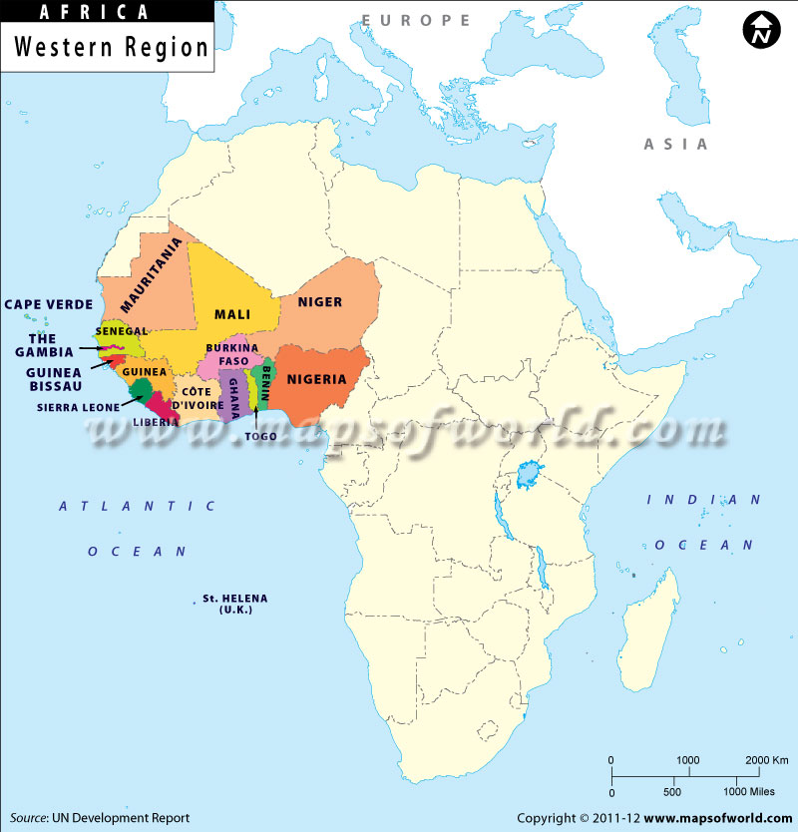
West Africa: Vegetation and Ecological Adaptations

Slide 22
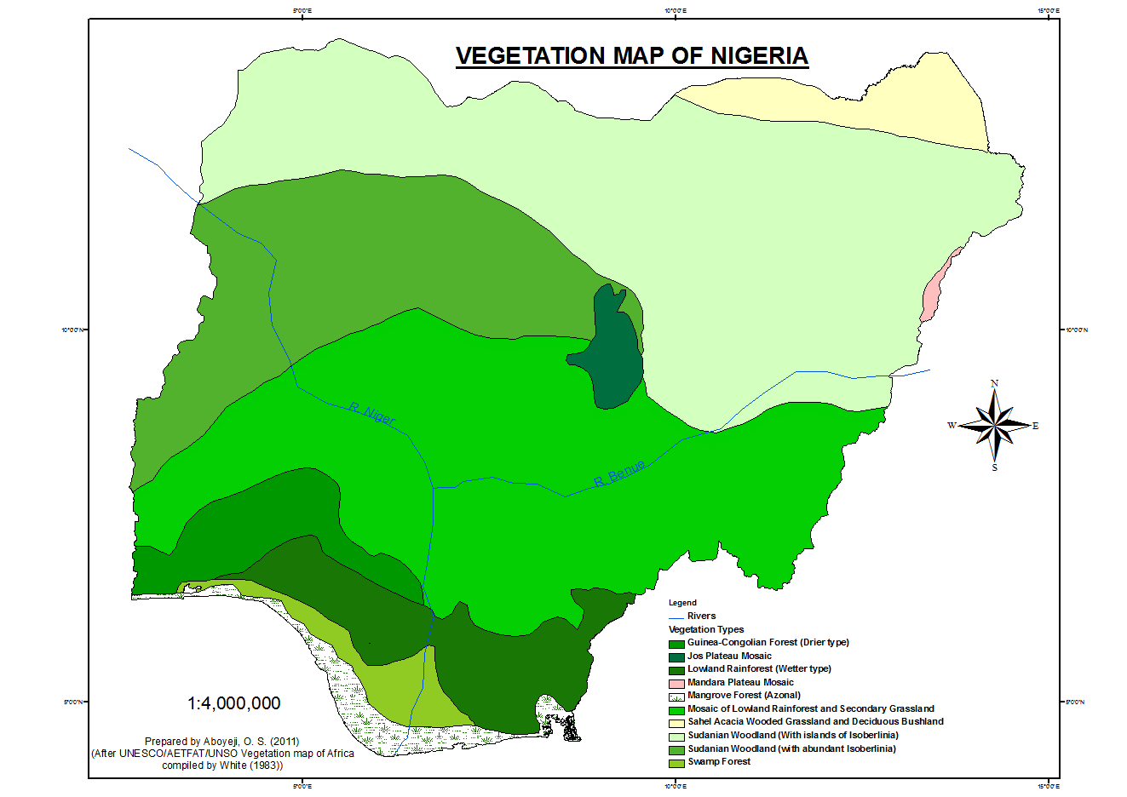

Slide 23
END For questions: gbenga.akomolafe@science.fulafia.edu.ng 08129069643

